Slide 1



Khadas vim 3 governor design
Team 9 – Levi & Anton

Slide 2

preliminaries
Problem | Constraints | Objective | Outputs

Slide 3
PROBLEM
Improve effectiveness of governor design
‘Design a more power-efficient governor than example governor to manage power of embedded system’
Governor
Minimize the frequencies of the Big CPU and Little CPU
Determine the locations of the two partitioning points
Reach target FPS and target latency

Slide 4
CONSTRAINTS

Slide 5
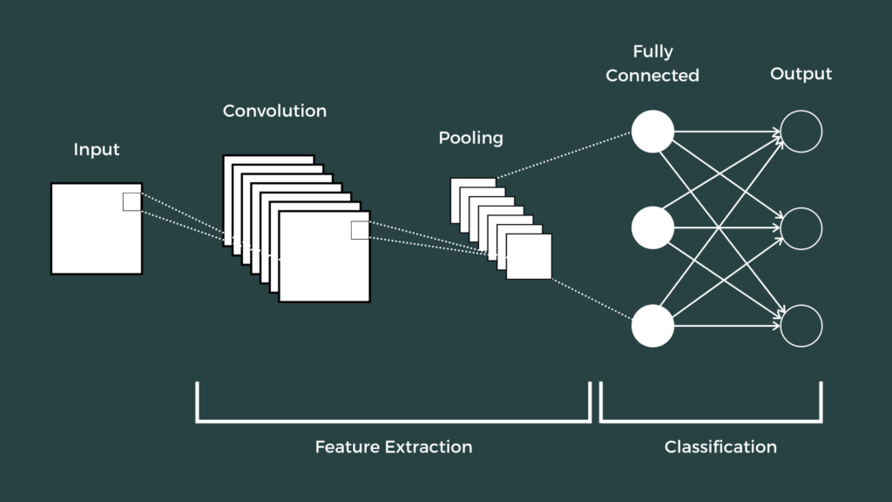


CONSTRAINTS

Slide 6
DESIGN POINT
Frequency of Big CPU
Frequency of Little CPU
Processors order in pipeline
2 partitioning points

Slide 7
Experiment phase
How Team 9 prepared for governor design

Slide 8
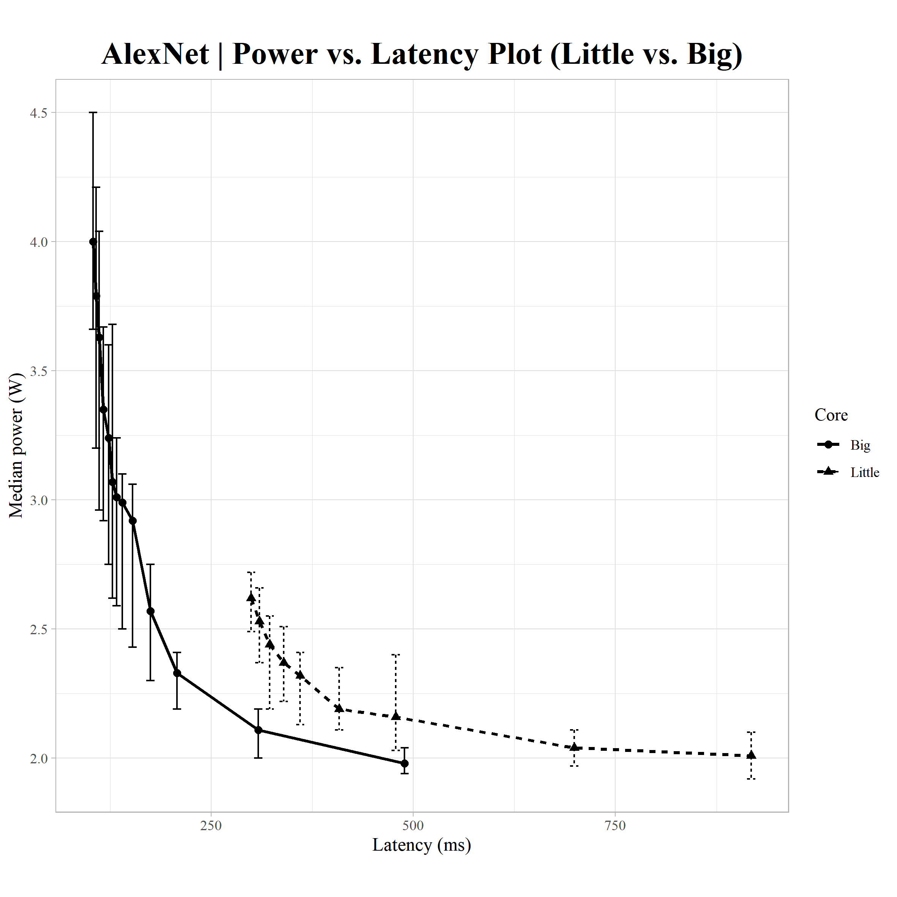
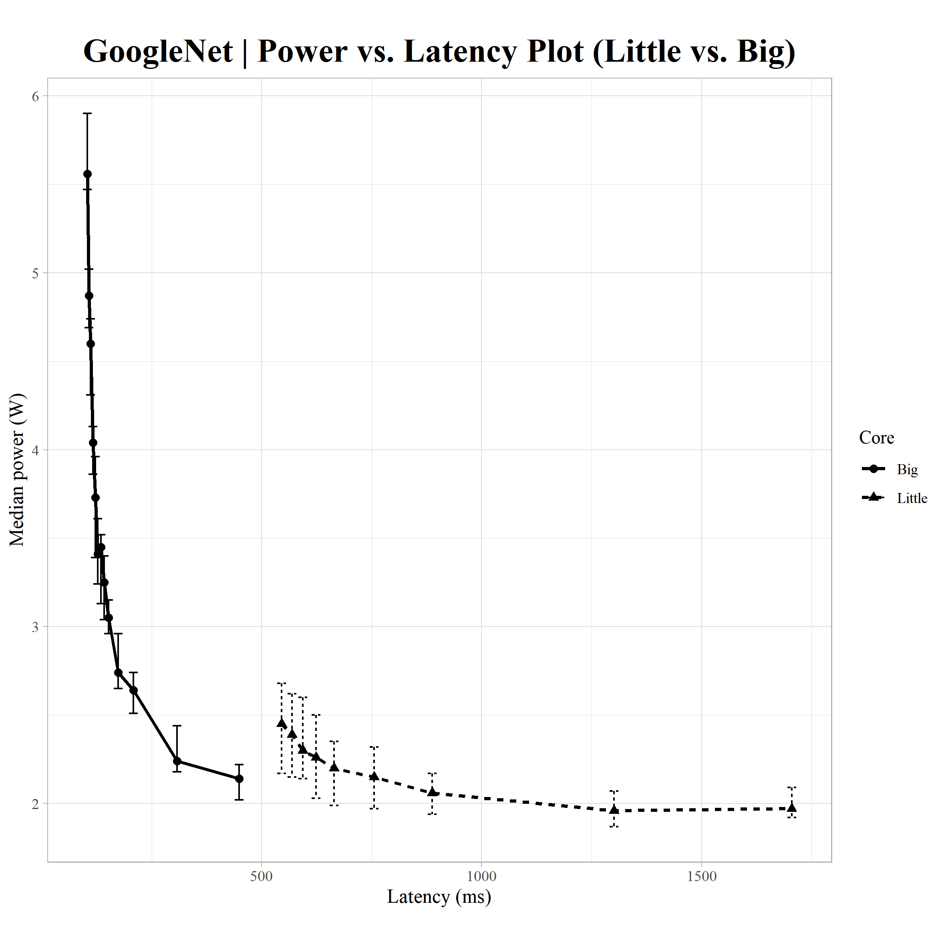
Power consumption
Big vs. Little CPUs

Slide 9
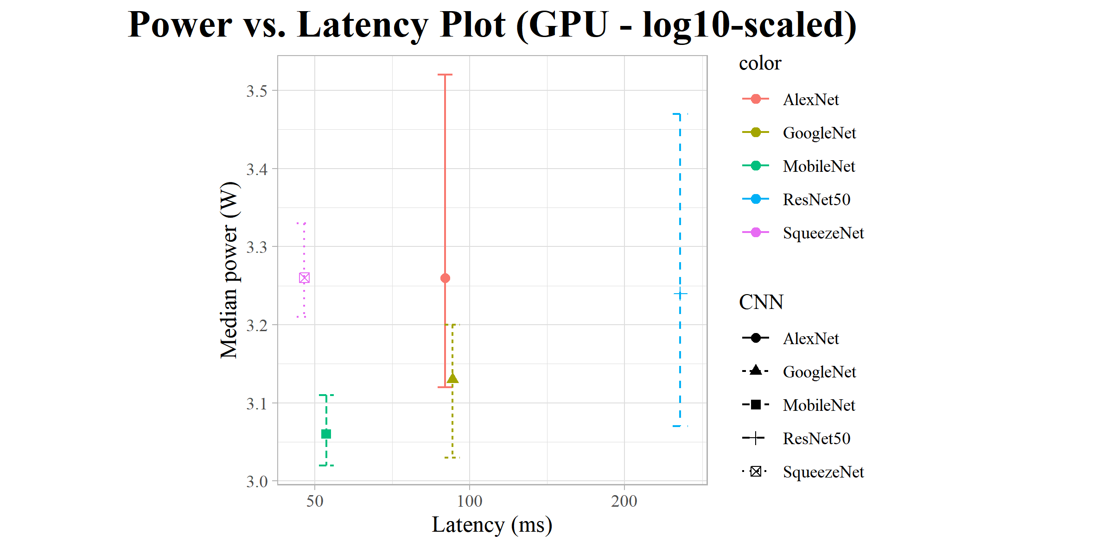
Power consumption
GPU

Slide 10
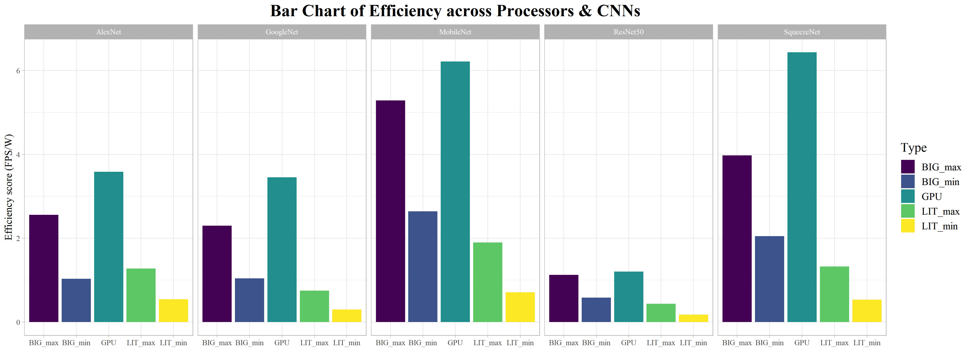
efficiency
Across Processors & CNNs

Slide 11
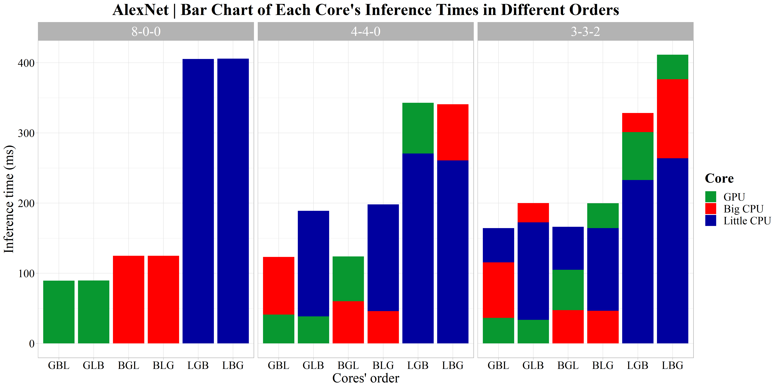
ORDERS

Slide 12
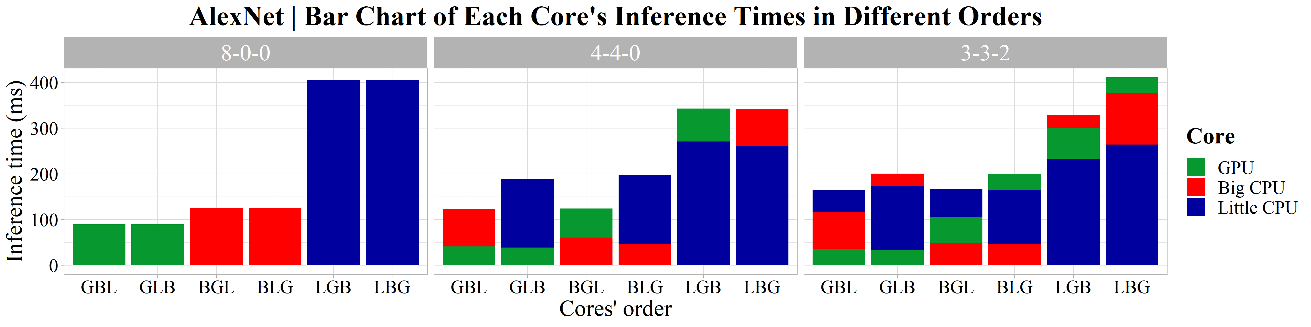
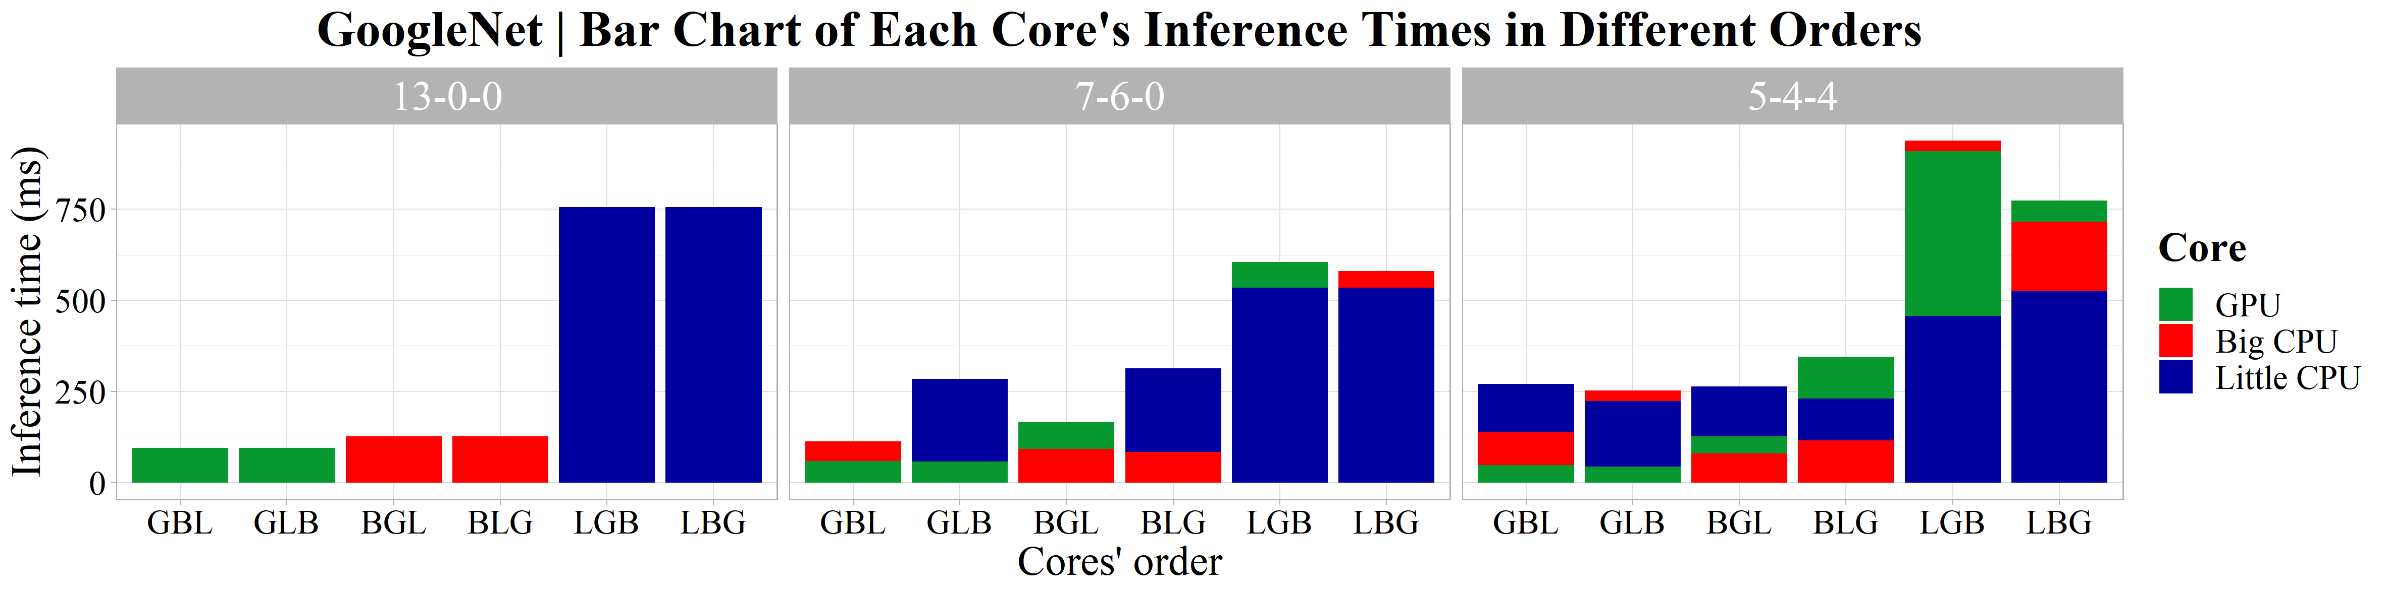
ORDERS

Slide 13
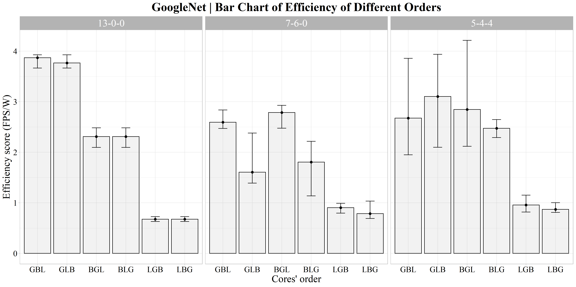
ORDERS EFFICIENCY

Slide 14
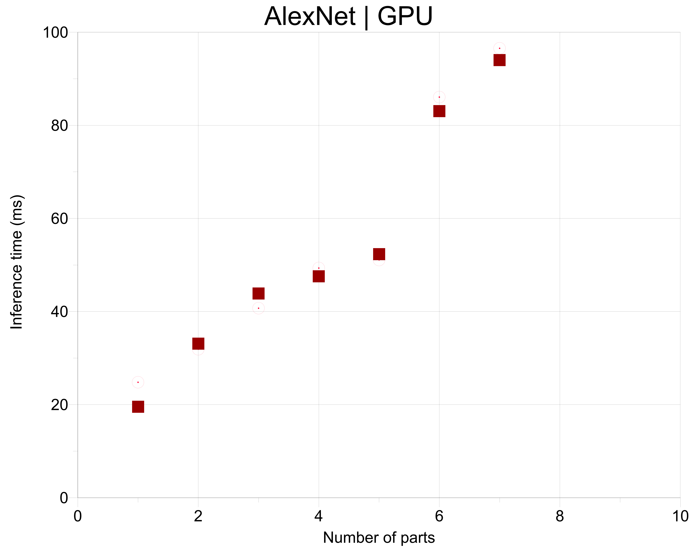
WORKLOAD IN ONE PART

Slide 15
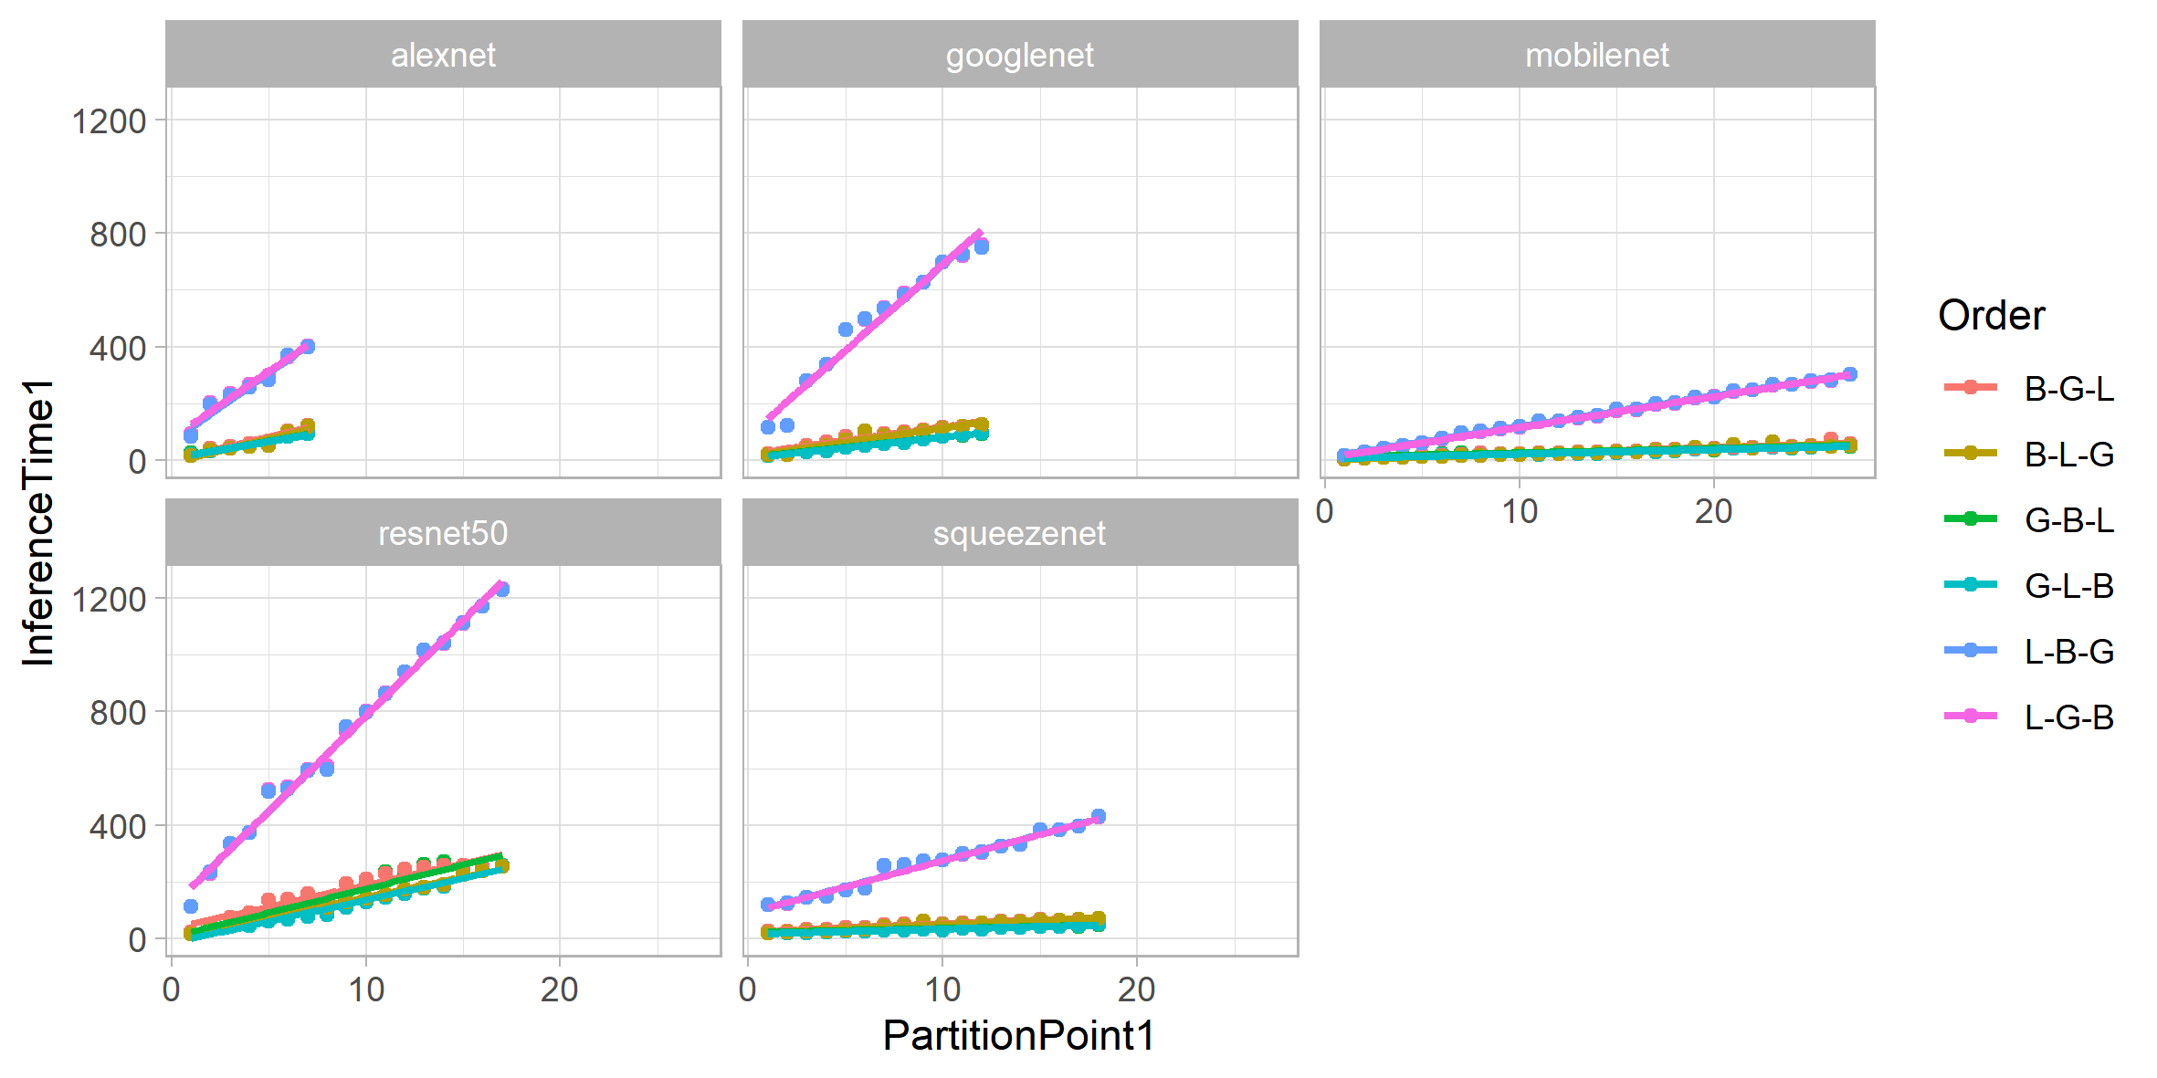
WORKLOAD IN PARTS

Slide 16
Governor design
Decision Tree | Frequencies Adjustment | Load Balancer

Slide 17
GOVERNER DESIGN APPROACH
Driven by data from experiments
Divide problem into smaller sub-problems
Simplify search space of {[Big Frequency, Little Frequency, Power]}
Partition workload evenly between CNNs

Slide 18

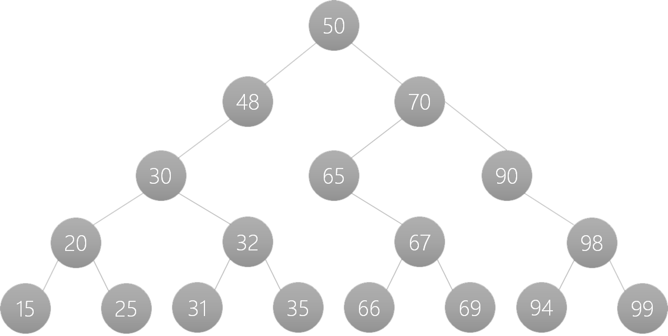
Binary search tree
5 layers
Mixes from performance and power.
Find a good starting point.

Slide 19
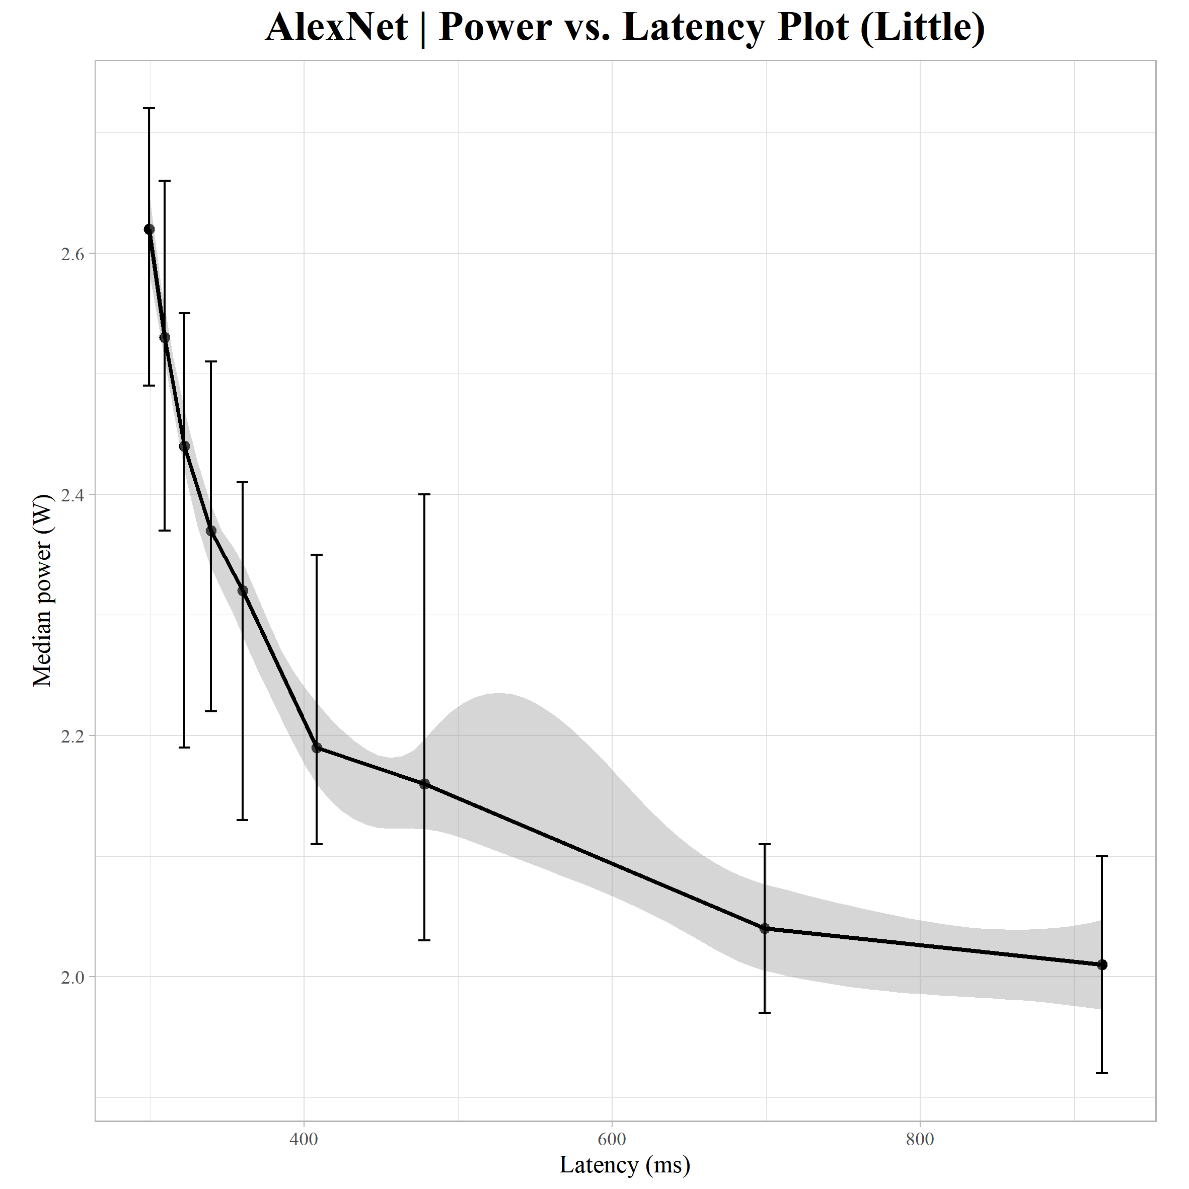
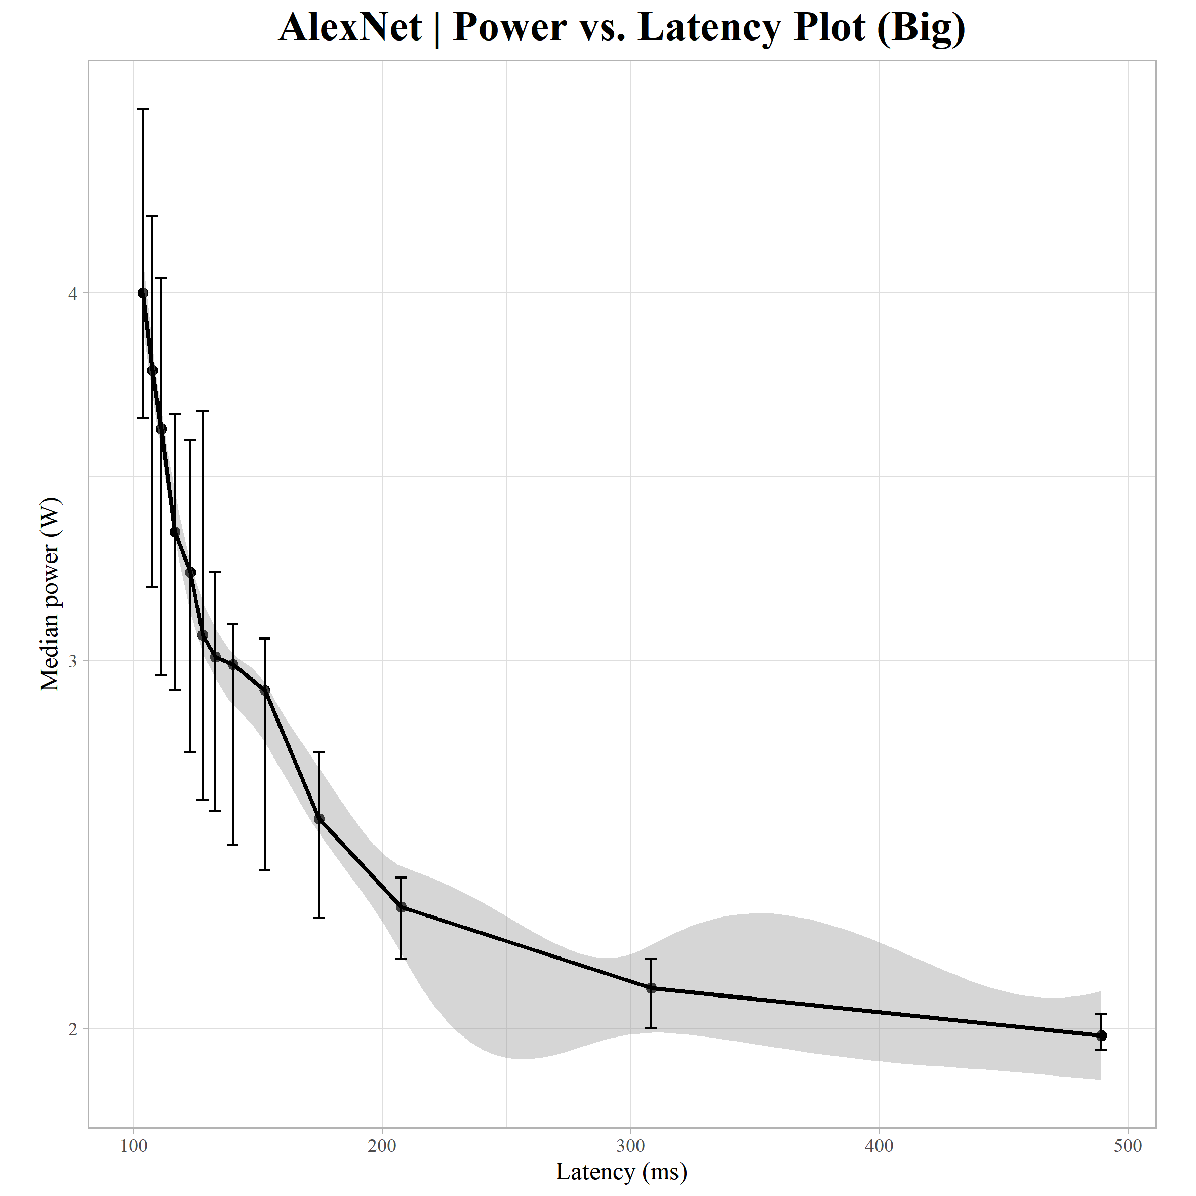
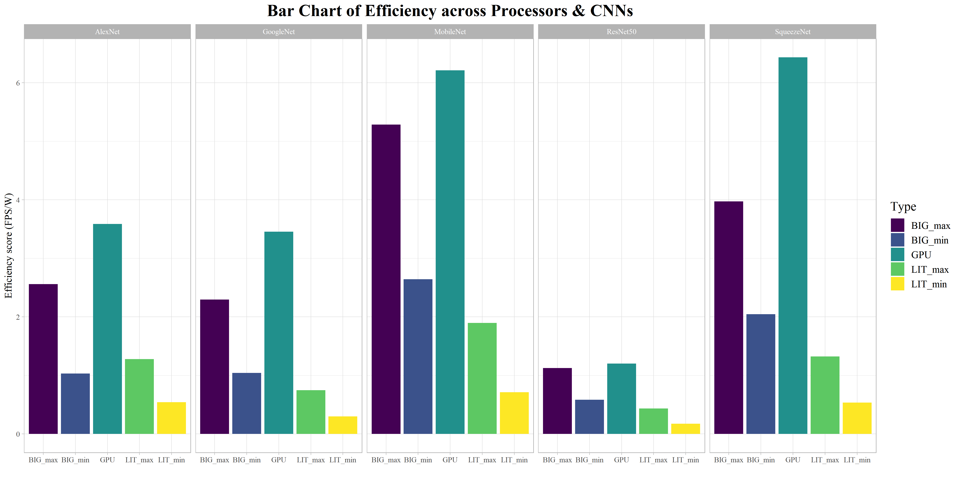
Binary search tree
5 layers
Mixes from performance and power.
Find a good starting point.

Slide 20
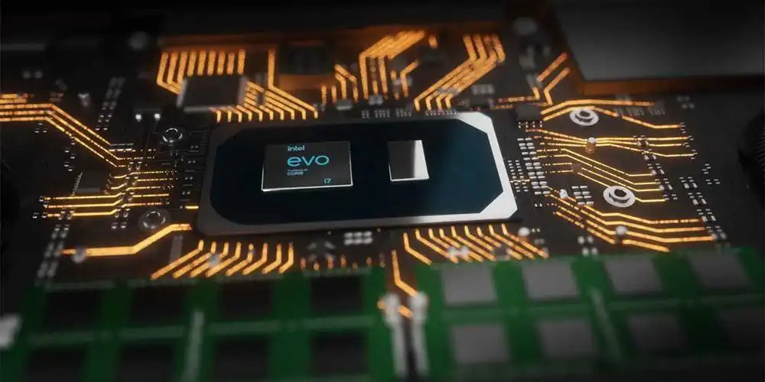
Load balancer
The interesting part
Look at slowest part.
And first looks at lowering frequency before moving the load
Otherwise moves the load.

Slide 21
Load balancer
The interesting part
Look at slowest part.
And first looks at lowering frequency before moving the load
Otherwise moves the load.

Slide 22
RESULTS
Team 9’s Governor vs. Demo Governor

Slide 23
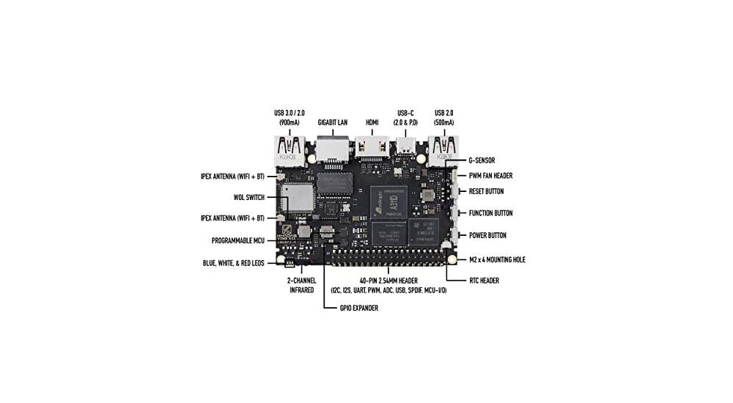
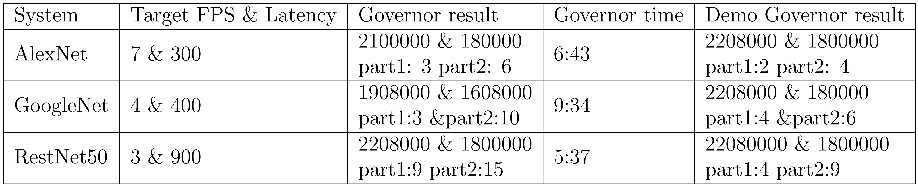
results
Avg. ↓24% power consumption (± 12.69%)

Slide 24

Q&A

